Slide 1
4. Psychoacoustic principles
Xavier Serra

Slide 2
Index
Psychoacoustic model in perceptual coding
Auditory system
Critical bands - Bark scale
Hearing threshold
Loudness and frequency
Frequency masking
Spatial hearing
MPEG Audio bit allocation

Slide 3
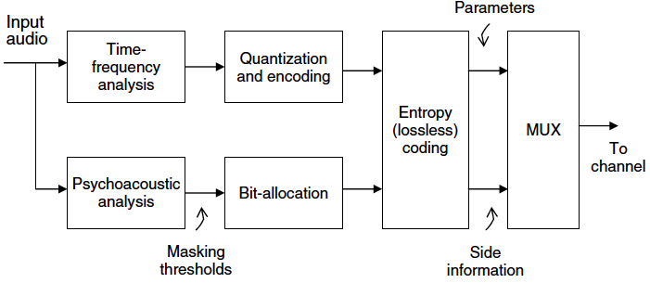
Psychoacoustic model
Loudness
Critical bands
Masking
  Frequency domain
  Time domain
Binaural cues

Slide 4
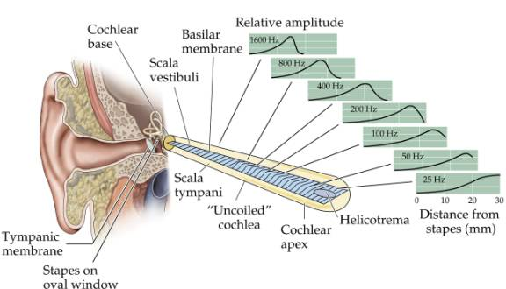
Auditory system

Slide 5
Basilar membrane as a filter bank.
Bank of highly overlapping bandpass filters.
The magnitude responses are asymmetric and nonlinear (level dependent).
Non-uniform bandwidth, and the bandwidths increase with increasing frequency.

Slide 6
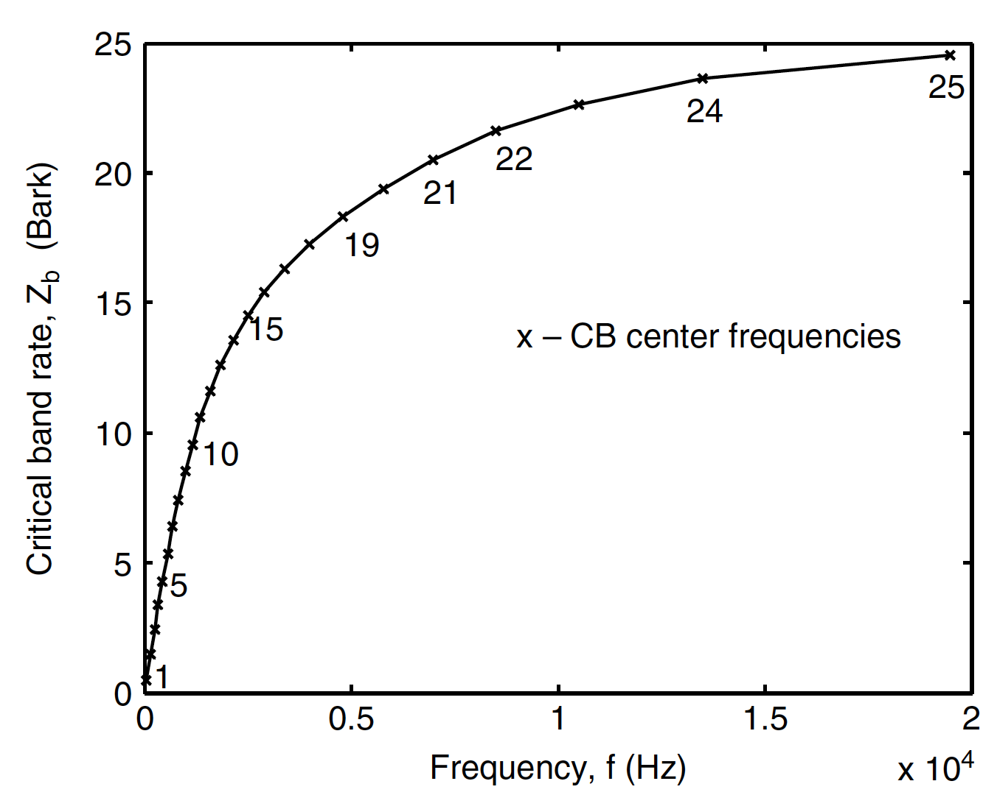
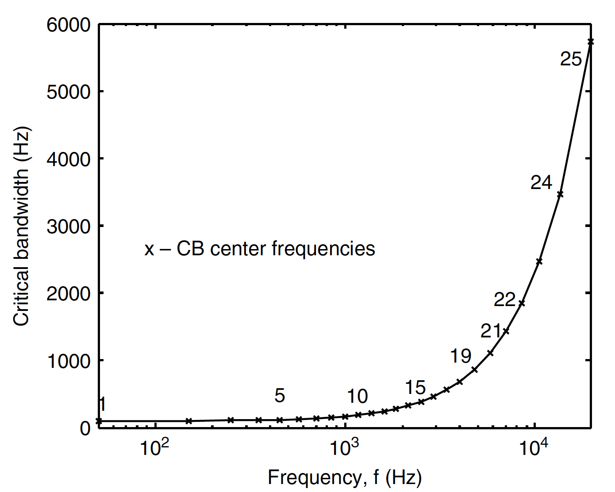

Critical Bands (Bark scale)
Critical band mapping from Hz to Bark
Critical bandwidth as a function of center frequency

Slide 7
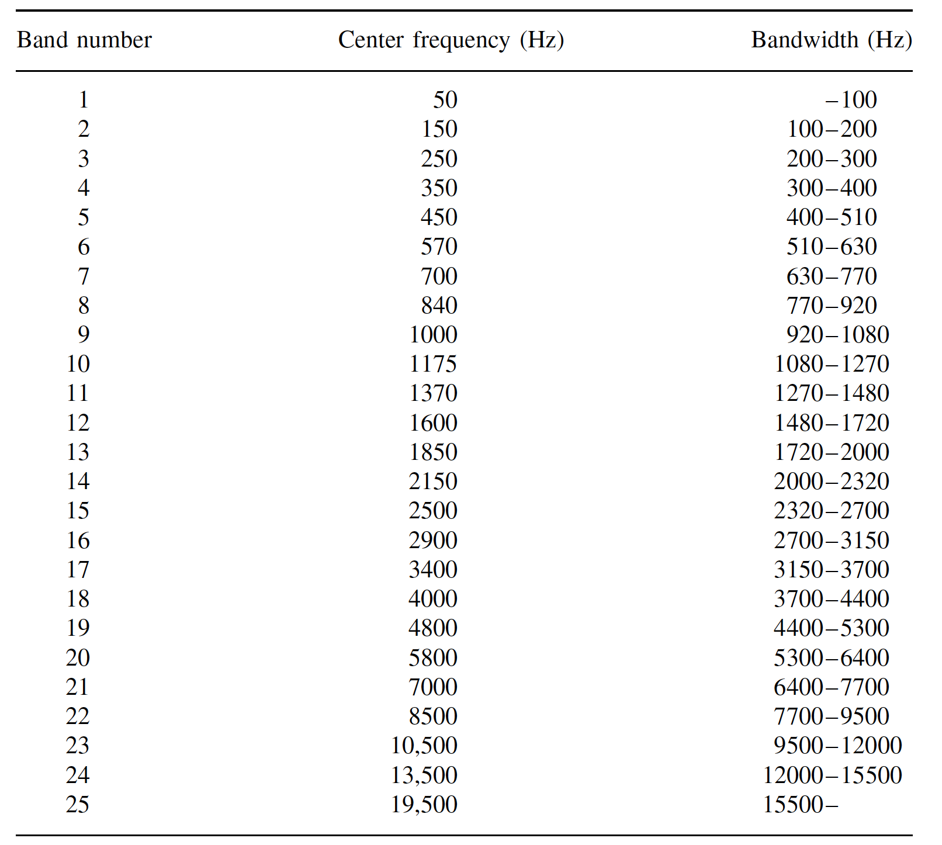
Critical band filter bank

Slide 8
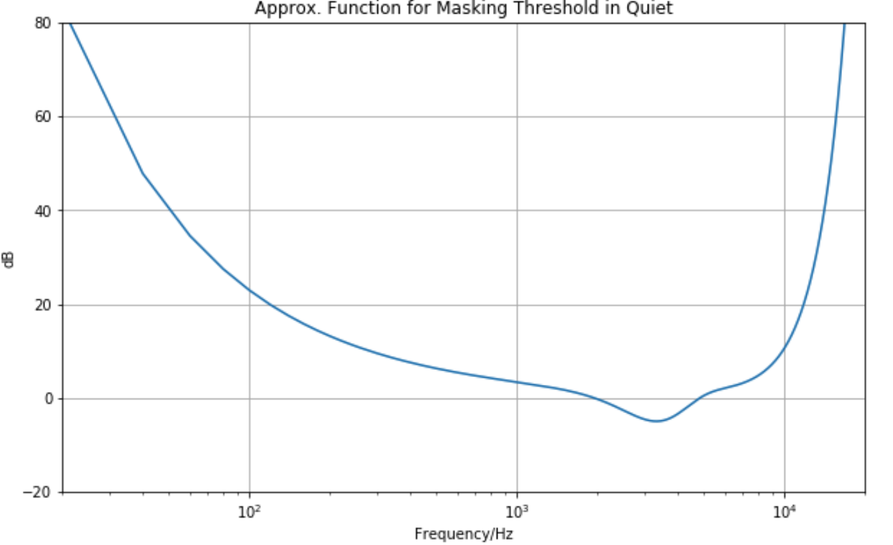
Absolute threshold of hearing

Slide 9
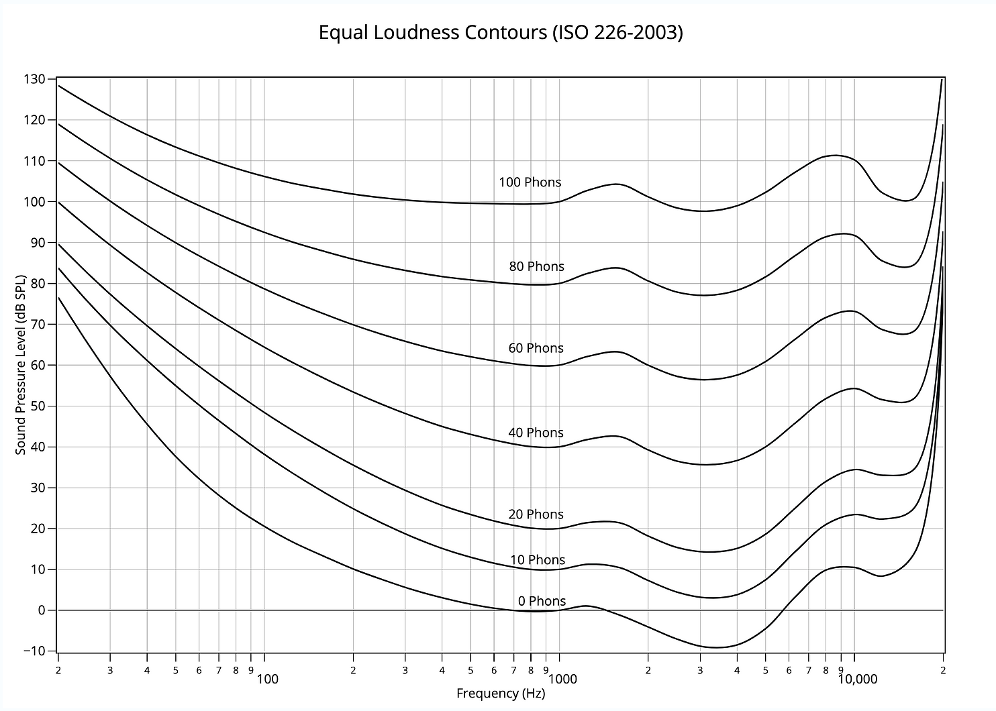
Loudness and frequency
More sensitive to loudness at mid frequencies than at other frequencies

Slide 10
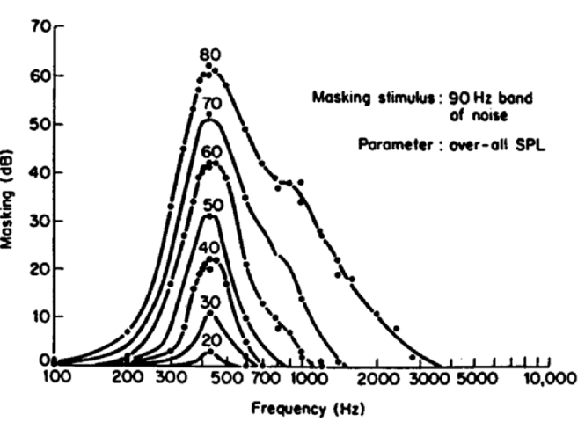
Frequency masking - spreading functions

Slide 11
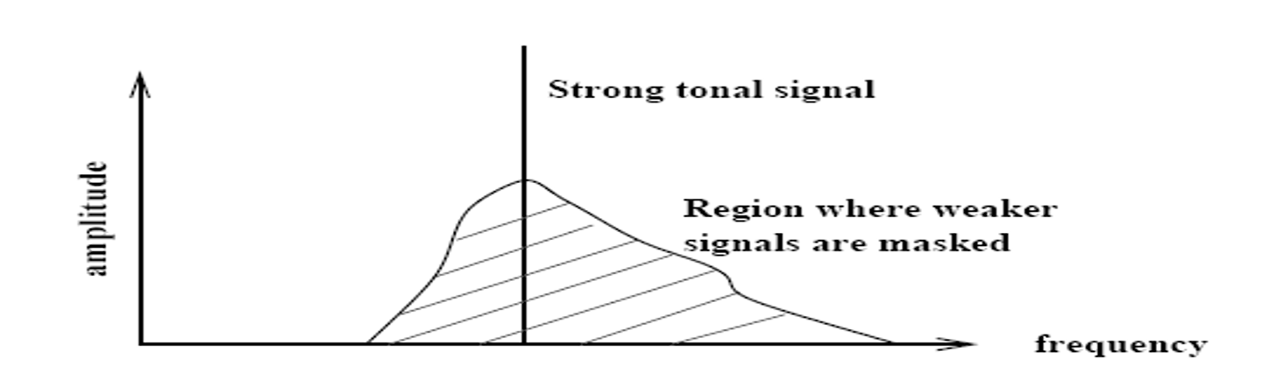
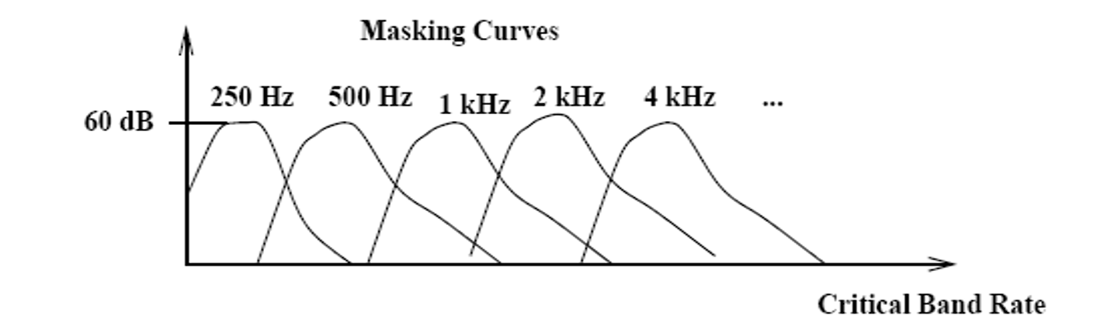
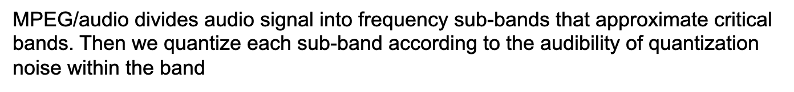

Slide 12
Tonality
Tonality index 𝞪:
Noisy signal: 𝞪 = 0
Tonal signal: 𝞪 = 1
Sharp spectral lines -> signal is periodic -> signal is predictable
We can use prediction to approximate if a signal is tonal (by periodicity)

Slide 13
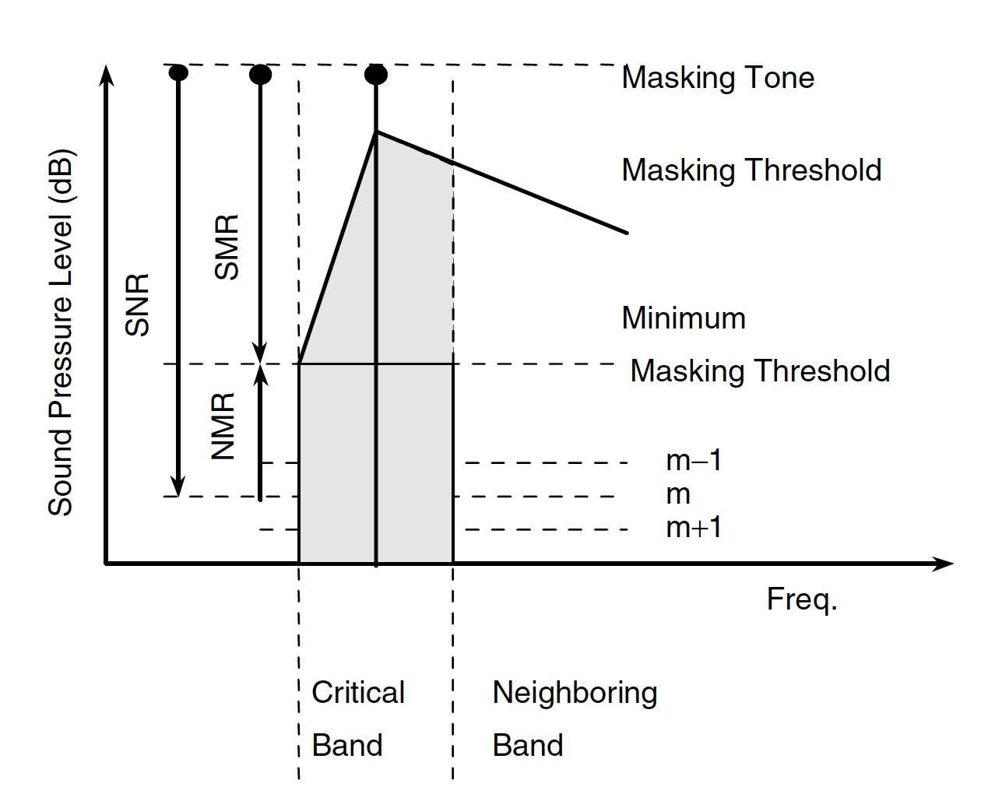
Simultaneous masking

Slide 14
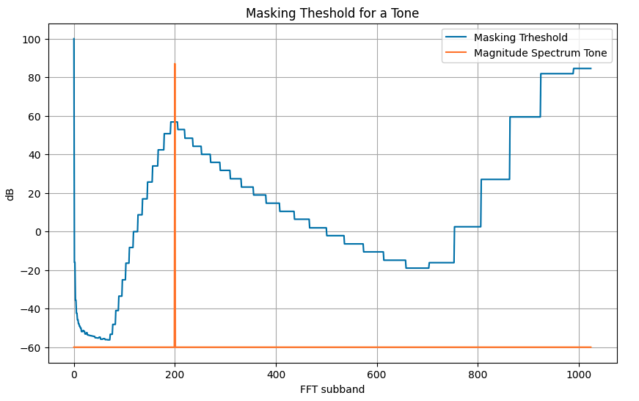

Slide 15
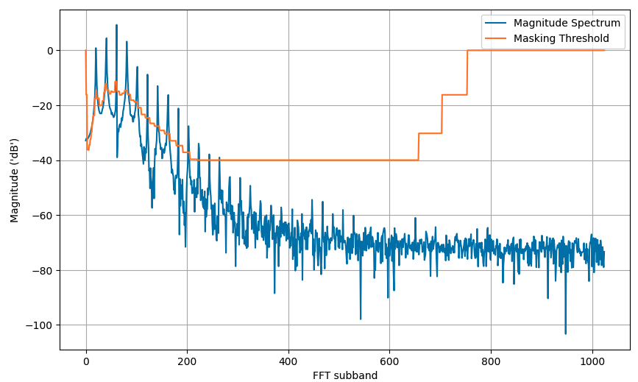

Global masking threshold

Slide 16
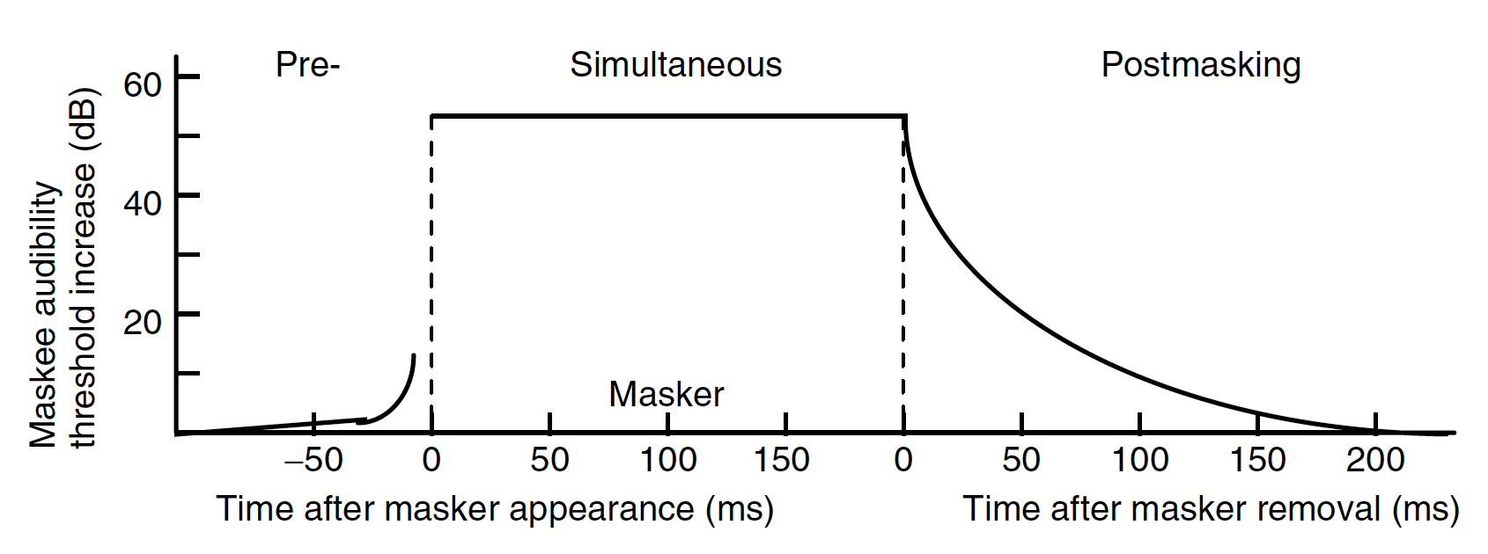
Non-simultaneous masking

Slide 17
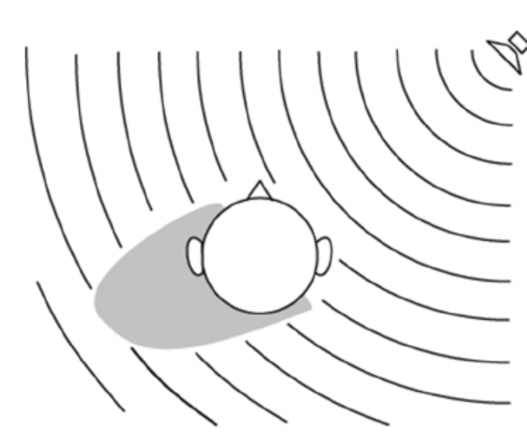
Spatial Hearing
Interaural Time Difference (ITD): Different ear arrival time due to different propagation paths.
Interaural Level Difference (ILD): Different sound pressure levels due to shadowing of the head (for high frequencies)

Slide 18
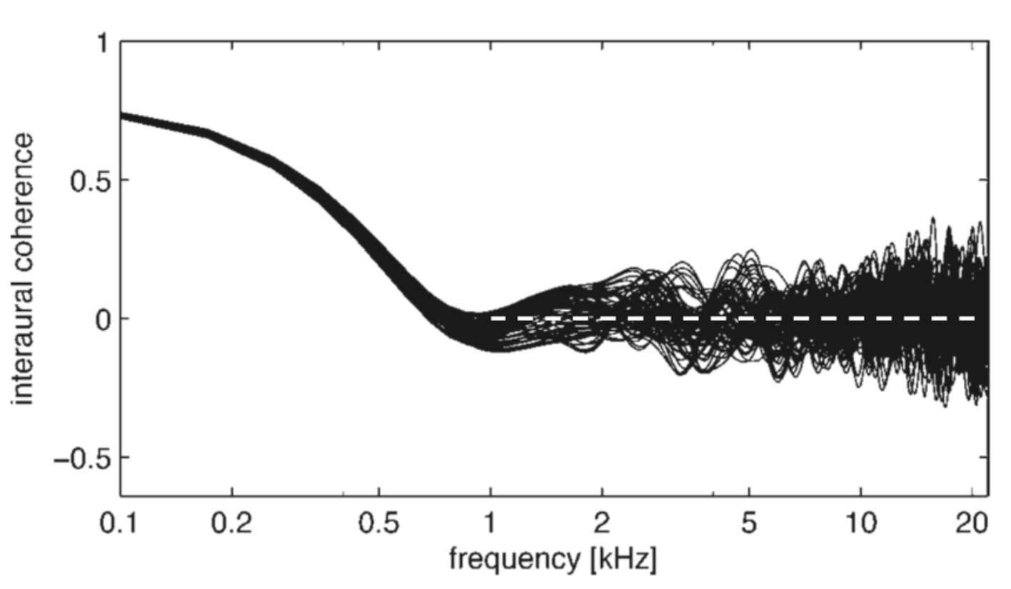
Interaural Coherence (IC): degree of “similarity” between left and right signals at the ears.
Inter-Channel Coherence (ICC): degree of “similarity” between left and right channels.
Measured frequency-dependent interaural coherence in diffuse reverberation

Slide 19
MPEG Audio Bit Allocation
This process determines number of code bits allocated to each sub-band based on information from the psychoacoustic model.
Algorithm:
Compute noise-to-mask ratio: NMR=SNR-SMR (dB).
  Standard provides tables that give estimates for SNR resulting from quantizing to a given number of quantizer levels.
Get NMR for each sub-band.
Search for sub-band with the lowest NMR.
Allocate code bits to this sub-band.
  If sub-band gets allocated more code bits than appropriate, look up new estimate of SNR and repeat step 1.

Slide 20
Audio Quality
Bitrate
With too low bit rate, we get compression artifacts
  Ringing.
  Pre-echo – sound is heard before it occurs. It is most noticeable in impulsive sounds from percussion instruments such as cymbals.
    Occurs in transform-based audio compression algorithms.
Quality of encoder and encoding parameters
Constant Bit rate encoding
Variable Bit rate encoding

Slide 21
References
“Chapter 5: Psychoacoustic principles” in Andreas Spanias, Ted Painter, and Venkatraman Atti (2007). Audio Signal Processing and Coding. John Wiley & Sons, Inc.
https://github.com/xserra/audio-coding-materials/
  examples/threshold-quiet.ipynb
  examples/bark-scale.ipynb
  examples/frequency-masking.ipynb

